Slide 1
Toward Energy-Efficient 5G A Machine Learning-Based Prediction Approach
Hamdi Barkous 27-10-2023

Slide 2
Table of contents
01
02
03
04
Introduction
Data Preprocessing
Feature Engineering
Model Development and Validation
05
06
Results
Discussion

Slide 3
01
Introduction

Slide 4
Motivation for the Study
Increasing energy consumption in 5G networks
Importance of base stations in energy consumption
Need for adaptive and flexible modeling

Slide 5
02
Data Preprocessing

Slide 6
Revised Data Structures
Refinement of `cell_level_data` and `base_station_info`
Introduction of new columns for primary cell
Pruning redundant columns

Slide 7
Handling of CellName Values
Dominant unique identifiers: 'CellName0' and 'CellName1'
Other 'CellName' instances merged into train and test sets
Notes:
A key part of our data processing was managing 'CellName' values. We chose to retain data from the two dominant identifiers and combined other instances into our primary datasets."

Slide 8
03
Feature Engineering
Notes:
Welcome everyone. Today, I'd like to discuss our study on 5G, the latest evolution in radio technology. While 5G brings numerous advancements, it also raises energy consumption concerns. Our research dives into leveraging machine learning to predict the energy consumption of 5G base stations.

Slide 9
Feature engineering
Introduction of new features: `load_sum`, `load_mult`
Deriving patterns and relationships from the data
Notes:
Feature engineering played a pivotal role in enhancing our model. We created new variables, such as `load_sum`, which aimed at extracting underlying patterns and connections present in our datasets.

Slide 10
Temporal Feature Engineering
Time-related features: Hour, Hour_sin, Is_weekend, etc.
Power utilization ratio
Energy-saving intensity from specific modes
Notes:
Feature engineering played a pivotal role in enhancing our model. We created new variables, such as `load_sum`, which aimed at extracting underlying patterns and connections present in our datasets.

Slide 11
Aggregative Feature Engineering
Grouping data by 'BS' identifiers
Generating statistical insights
Notes:
By clustering our data based on unique 'BS' identifiers, we dove deeper into the behavior of multiple stations. This approach assists our model in making predictions for unfamiliar stations by learning from known behaviors."

Slide 12
Encoding Categorical Features
Ordinal encoding of `BS`, `Mode`, and `RUType`
Notes:
By clustering our data based on unique 'BS' identifiers, we dove deeper into the behavior of multiple stations. This approach assists our model in making predictions for unfamiliar stations by learning from known behaviors."

Slide 13
Function Overview: `predict_next_load`
Uses XGBoost to forecast subsequent load values
Steps: Sorting, Iteration, Data preparation, Predictions
Notes:
By clustering our data based on unique 'BS' identifiers, we dove deeper into the behavior of multiple stations. This approach assists our model in making predictions for unfamiliar stations by learning from known behaviors."

Slide 14
04
Model Development and Validation
Notes:
Welcome everyone. Today, I'd like to discuss our study on 5G, the latest evolution in radio technology. While 5G brings numerous advancements, it also raises energy consumption concerns. Our research dives into leveraging machine learning to predict the energy consumption of 5G base stations.

Slide 15
Model Development and Validation
Key steps:
Grouping by Base Station for representative validation.
Employing `GroupKFold` cross-validation for real-world simulation.
Utilization of XGBoost Regressor for model training.
Evaluation using mean absolute error (MAE).
Iterative training and validation across cross-validation folds.
Notes:
By clustering our data based on unique 'BS' identifiers, we dove deeper into the behavior of multiple stations. This approach assists our model in making predictions for unfamiliar stations by learning from known behaviors."

Slide 16
XGBoost Model Details
Key Hyperparameters:
Objective: `reg:gamma`
Number of estimators: 2100
Learning rate: 0.05
Column sample by tree: 0.7
Subsample: 0.8
Maximum depth: 8
Regularization lambda: 5
Notes:
By clustering our data based on unique 'BS' identifiers, we dove deeper into the behavior of multiple stations. This approach assists our model in making predictions for unfamiliar stations by learning from known behaviors."

Slide 17
Post-Processing
Dataset characteristics: ~90,000 records but only ~600 unique values.
Differentiating predictions for known vs. unknown base stations.
Ensuring relevance and accuracy in predictions.
Notes:
By clustering our data based on unique 'BS' identifiers, we dove deeper into the behavior of multiple stations. This approach assists our model in making predictions for unfamiliar stations by learning from known behaviors."

Slide 18
05
Results Overview
Notes:
Welcome everyone. Today, I'd like to discuss our study on 5G, the latest evolution in radio technology. While 5G brings numerous advancements, it also raises energy consumption concerns. Our research dives into leveraging machine learning to predict the energy consumption of 5G base stations.

Slide 19
Quantitative Model Results
Weighted Mean Absolute Percentage Error (WMAPE): 7.7%
Density distribution visualization for training vs. test data comparison.
Notes:
By clustering our data based on unique 'BS' identifiers, we dove deeper into the behavior of multiple stations. This approach assists our model in making predictions for unfamiliar stations by learning from known behaviors."

Slide 20
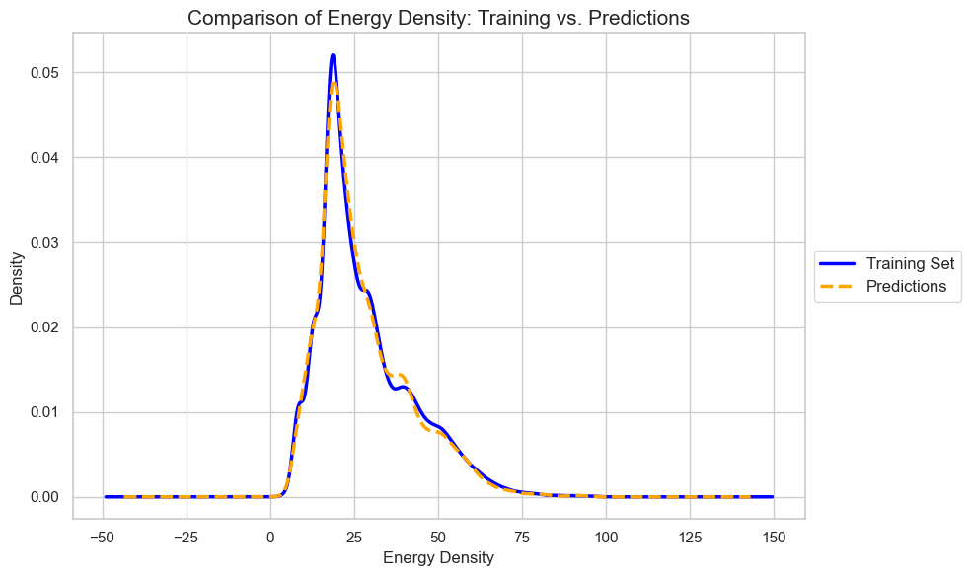
Density Distribution
Close overlap around peak values.
Some deviations observed at the tails.
Notes:
As you can see from the density plot, our model's predictions closely resemble the training data's distribution, especially around peak values. However, the tails hint at possible areas for improvement."

Slide 21
06
Discussion
Notes:
Welcome everyone. Today, I'd like to discuss our study on 5G, the latest evolution in radio technology. While 5G brings numerous advancements, it also raises energy consumption concerns. Our research dives into leveraging machine learning to predict the energy consumption of 5G base stations.

Slide 22
Model Limitations
Data granularity might miss short-lived fluctuations.
Model simplifications can lead to minor discrepancies.
Notes:
By clustering our data based on unique 'BS' identifiers, we dove deeper into the behavior of multiple stations. This approach assists our model in making predictions for unfamiliar stations by learning from known behaviors."

Slide 23
Future Work
Explore data at finer granularities.
Incorporate advanced modeling techniques for enhanced accuracy.
Notes:
By clustering our data based on unique 'BS' identifiers, we dove deeper into the behavior of multiple stations. This approach assists our model in making predictions for unfamiliar stations by learning from known behaviors."

Slide 24
Conclusion
Notes:
By clustering our data based on unique 'BS' identifiers, we dove deeper into the behavior of multiple stations. This approach assists our model in making predictions for unfamiliar stations by learning from known behaviors."

Slide 25
Thank you for your attention !
Notes:
By clustering our data based on unique 'BS' identifiers, we dove deeper into the behavior of multiple stations. This approach assists our model in making predictions for unfamiliar stations by learning from known behaviors."

